Slide 1
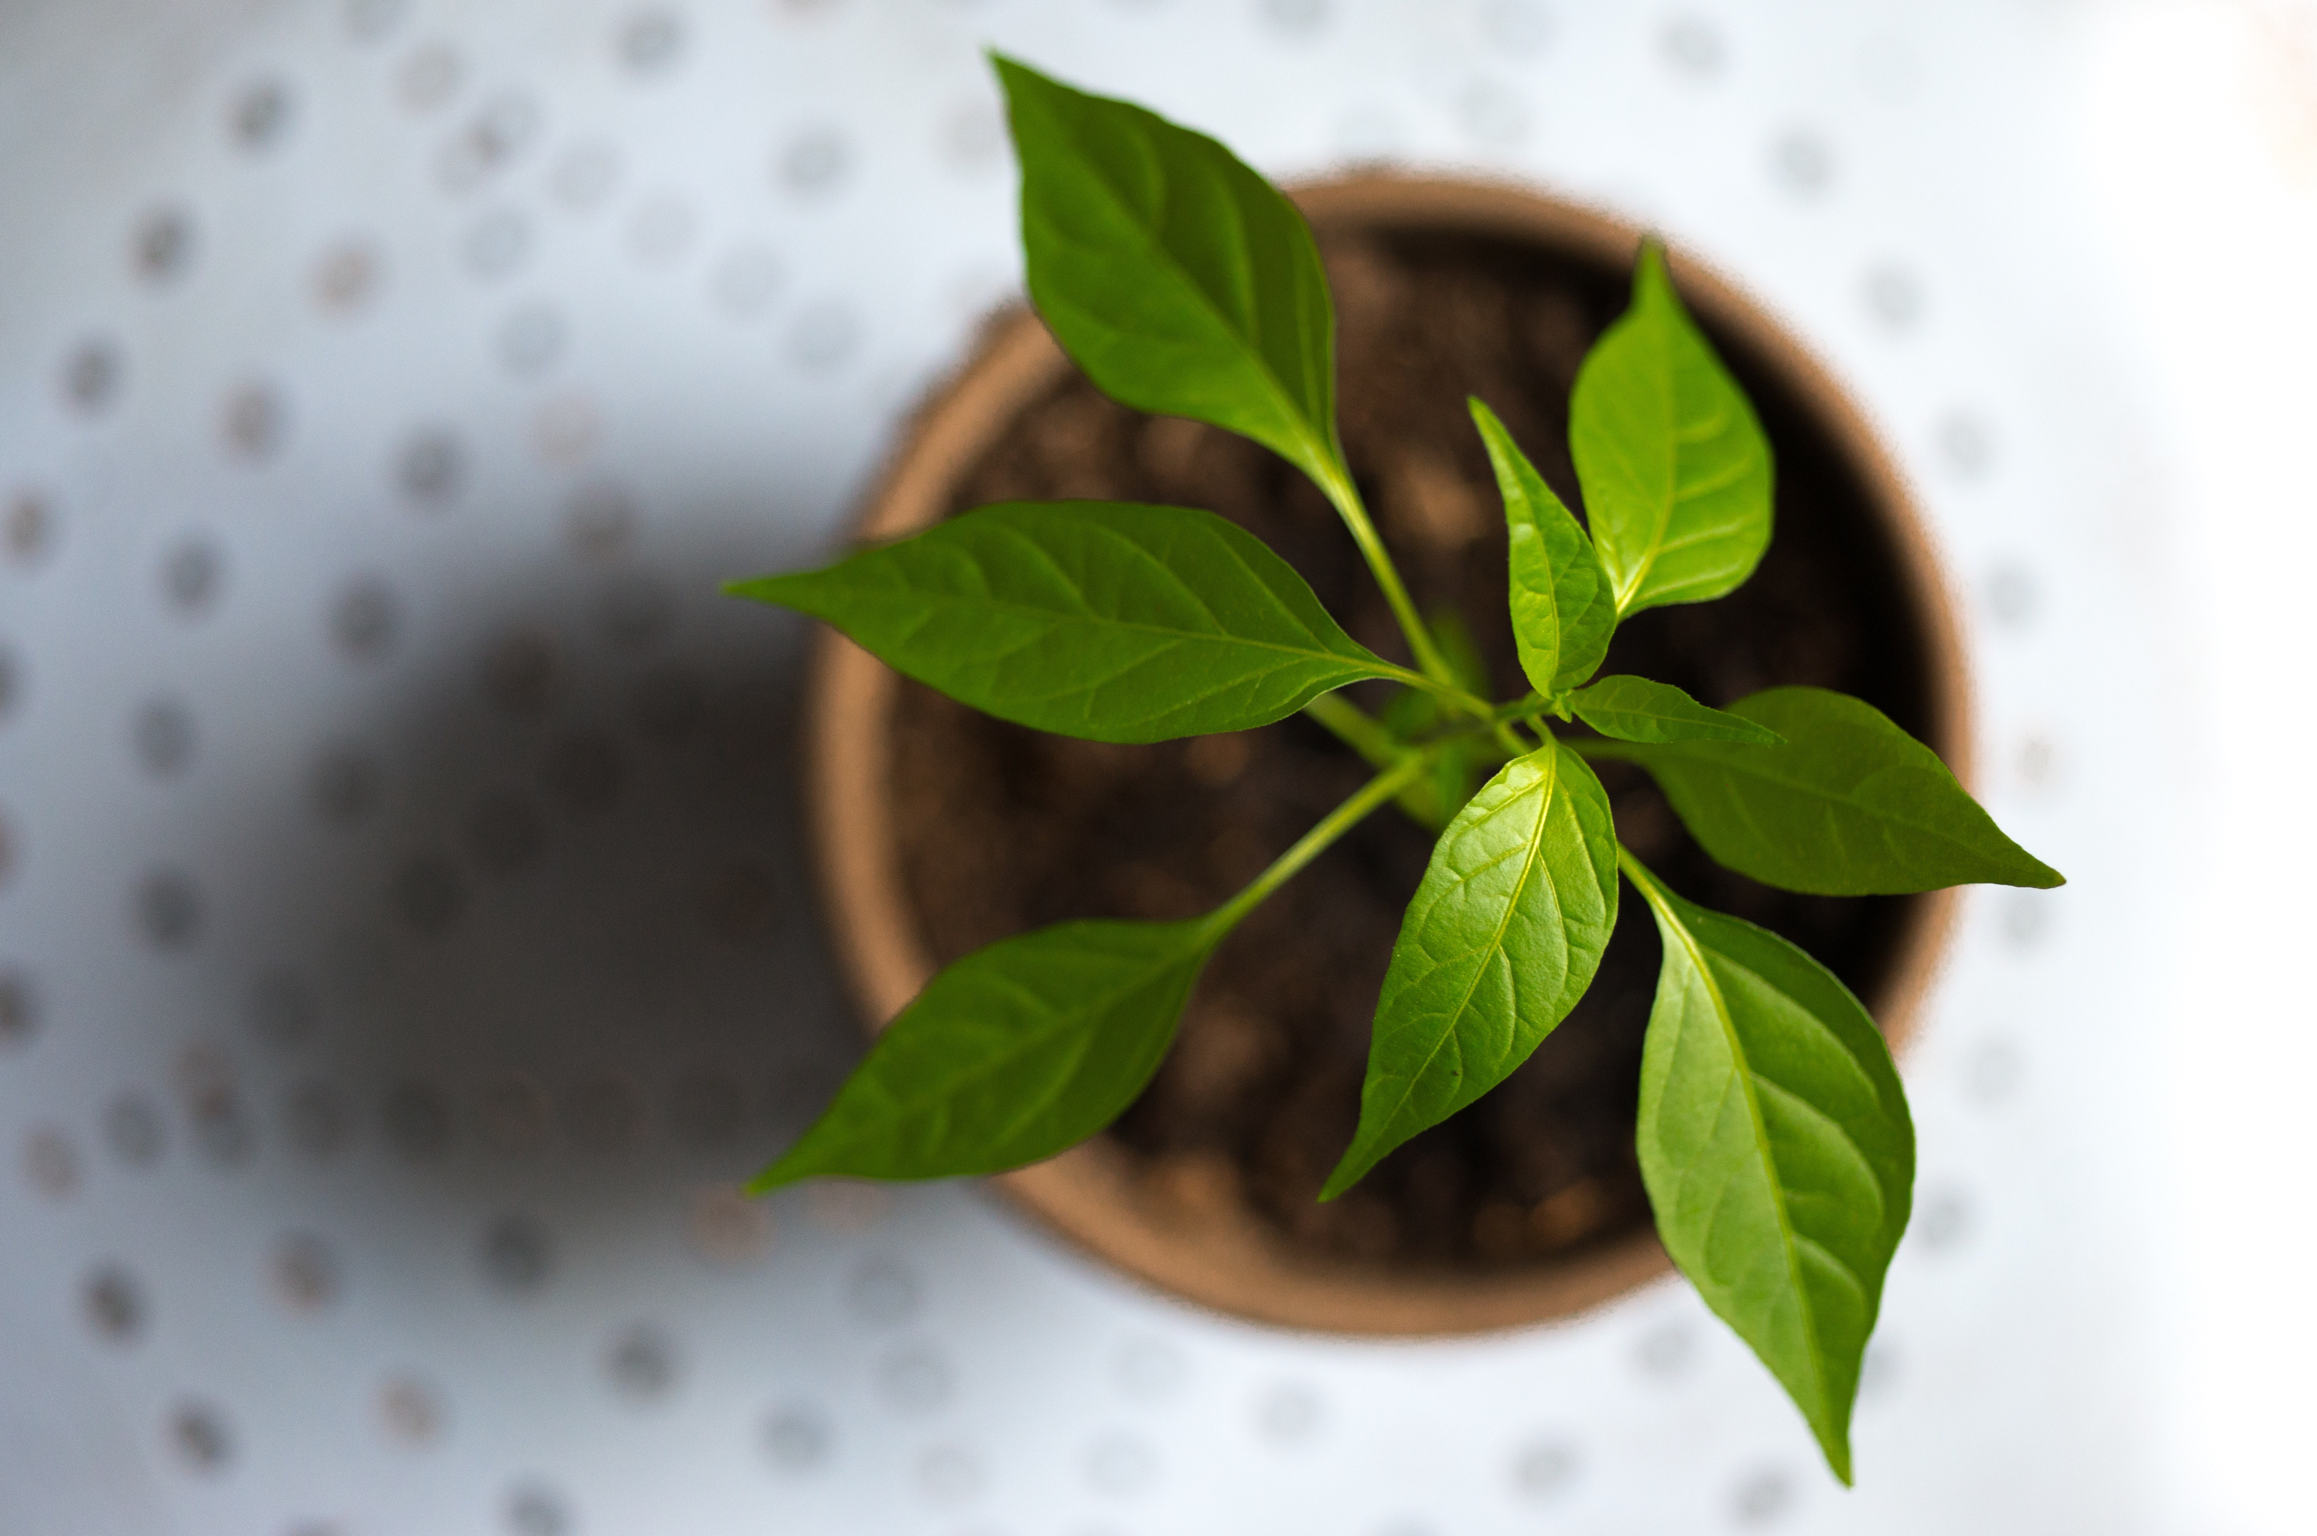
P L A N T O M A T I C - F I N A L P R E S E N T A T I O N

Slide 2
A G E N D A
THE CONCEPT
MACHINE LEARNING
THE DEMO
1
3
5
2
4
6
PRE PROCESSING
THE RESULTS
OPEN DISCUSSION
Notes:
Auf dieser Folie werde ich die überpunkte vorstellen und sagen wer was vorstellt:
Grobes konzept/initiale ideen
Pre Processing Pipe
Carsten auf Machine Learning
Johannes präsentiert ergebnis und erklärt das scoring modell
Eine kleine demonstration
Offne diskussion

Slide 3
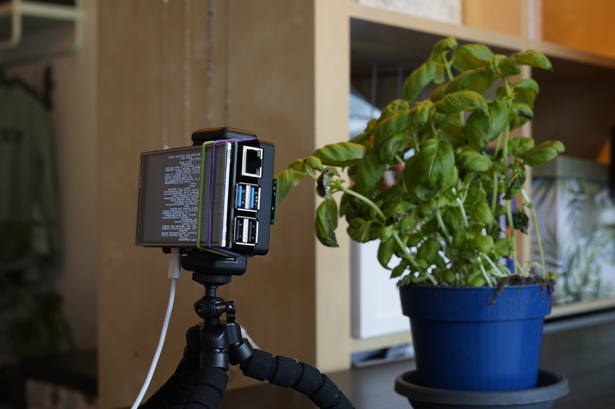
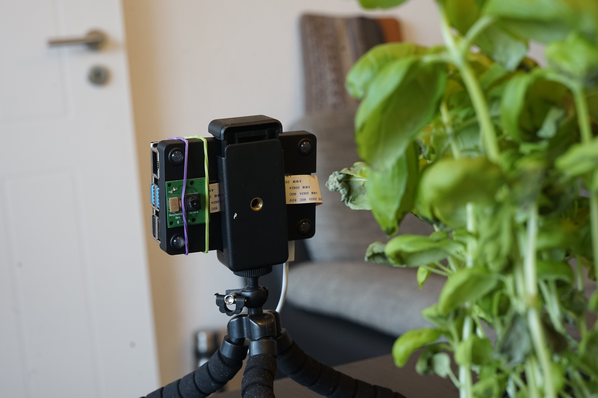
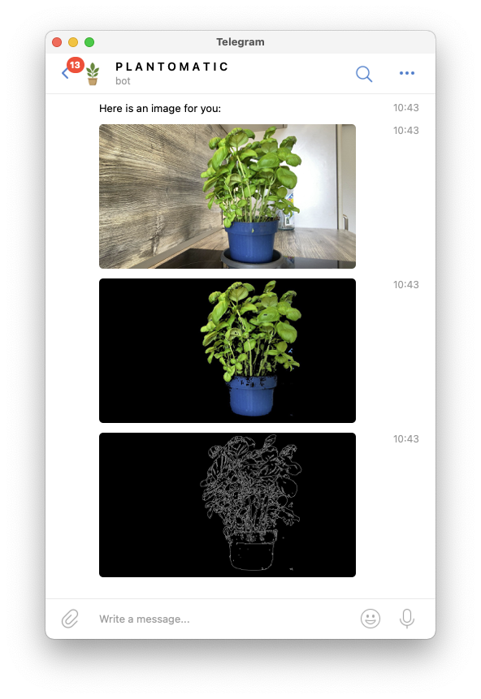
REALTIME PLANT INFORMATION SYSTEM
THE CONCEPT

Slide 4
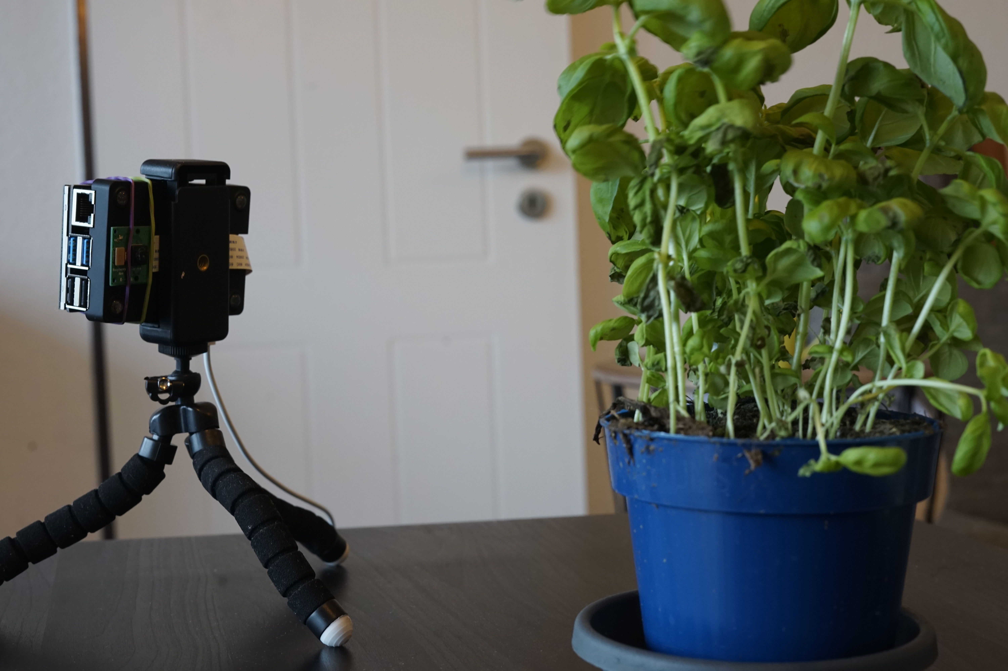
INITIAL IDEAS - FEATURE ANALYSIS
Prepare images for later ML
Use Raspberry Pi as “robot”
Get mobile notifications via Telegram API
Data Gathereing > Video

Slide 5
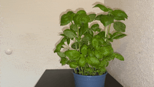
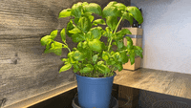
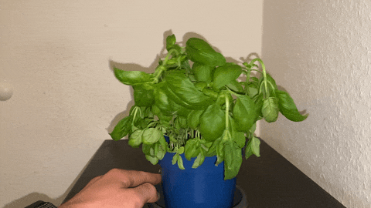
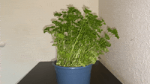
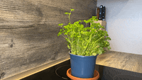
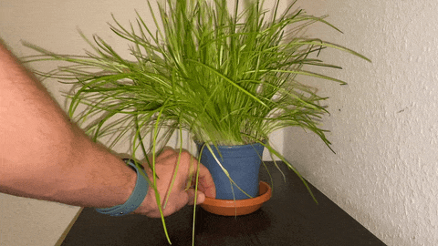
Observe Plants until dried
Take videos every x hours
Taking notes of current state
THE PLANT DIARY

Slide 6





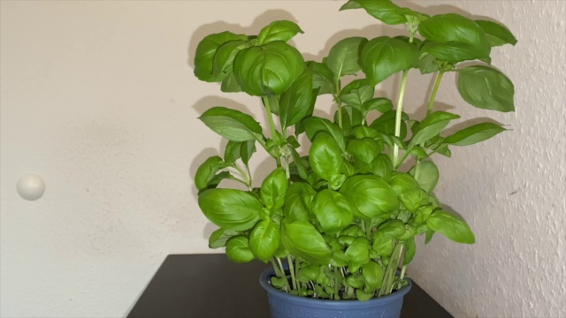
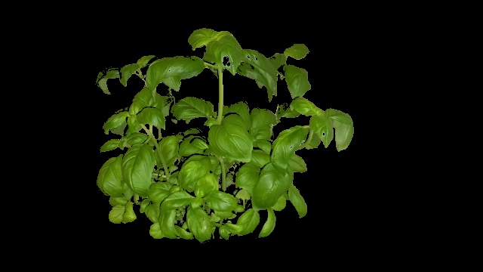
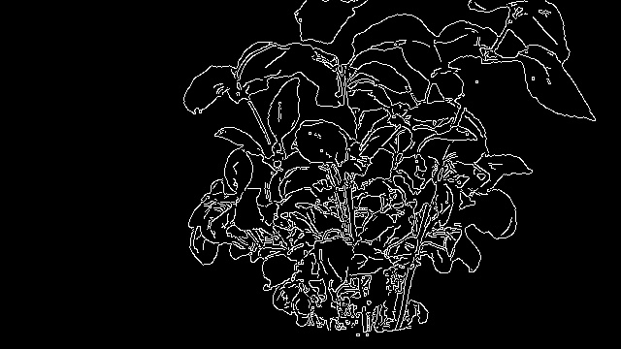
1. VIDEO TO FRAMES
3. EVERY NTH FRAME
2. LAPLACE FILTER
> VARIANCE
5. CANNY EDGE DETECTION
4. GREEN MASK
PRE PROCESSING PIPE

Slide 7
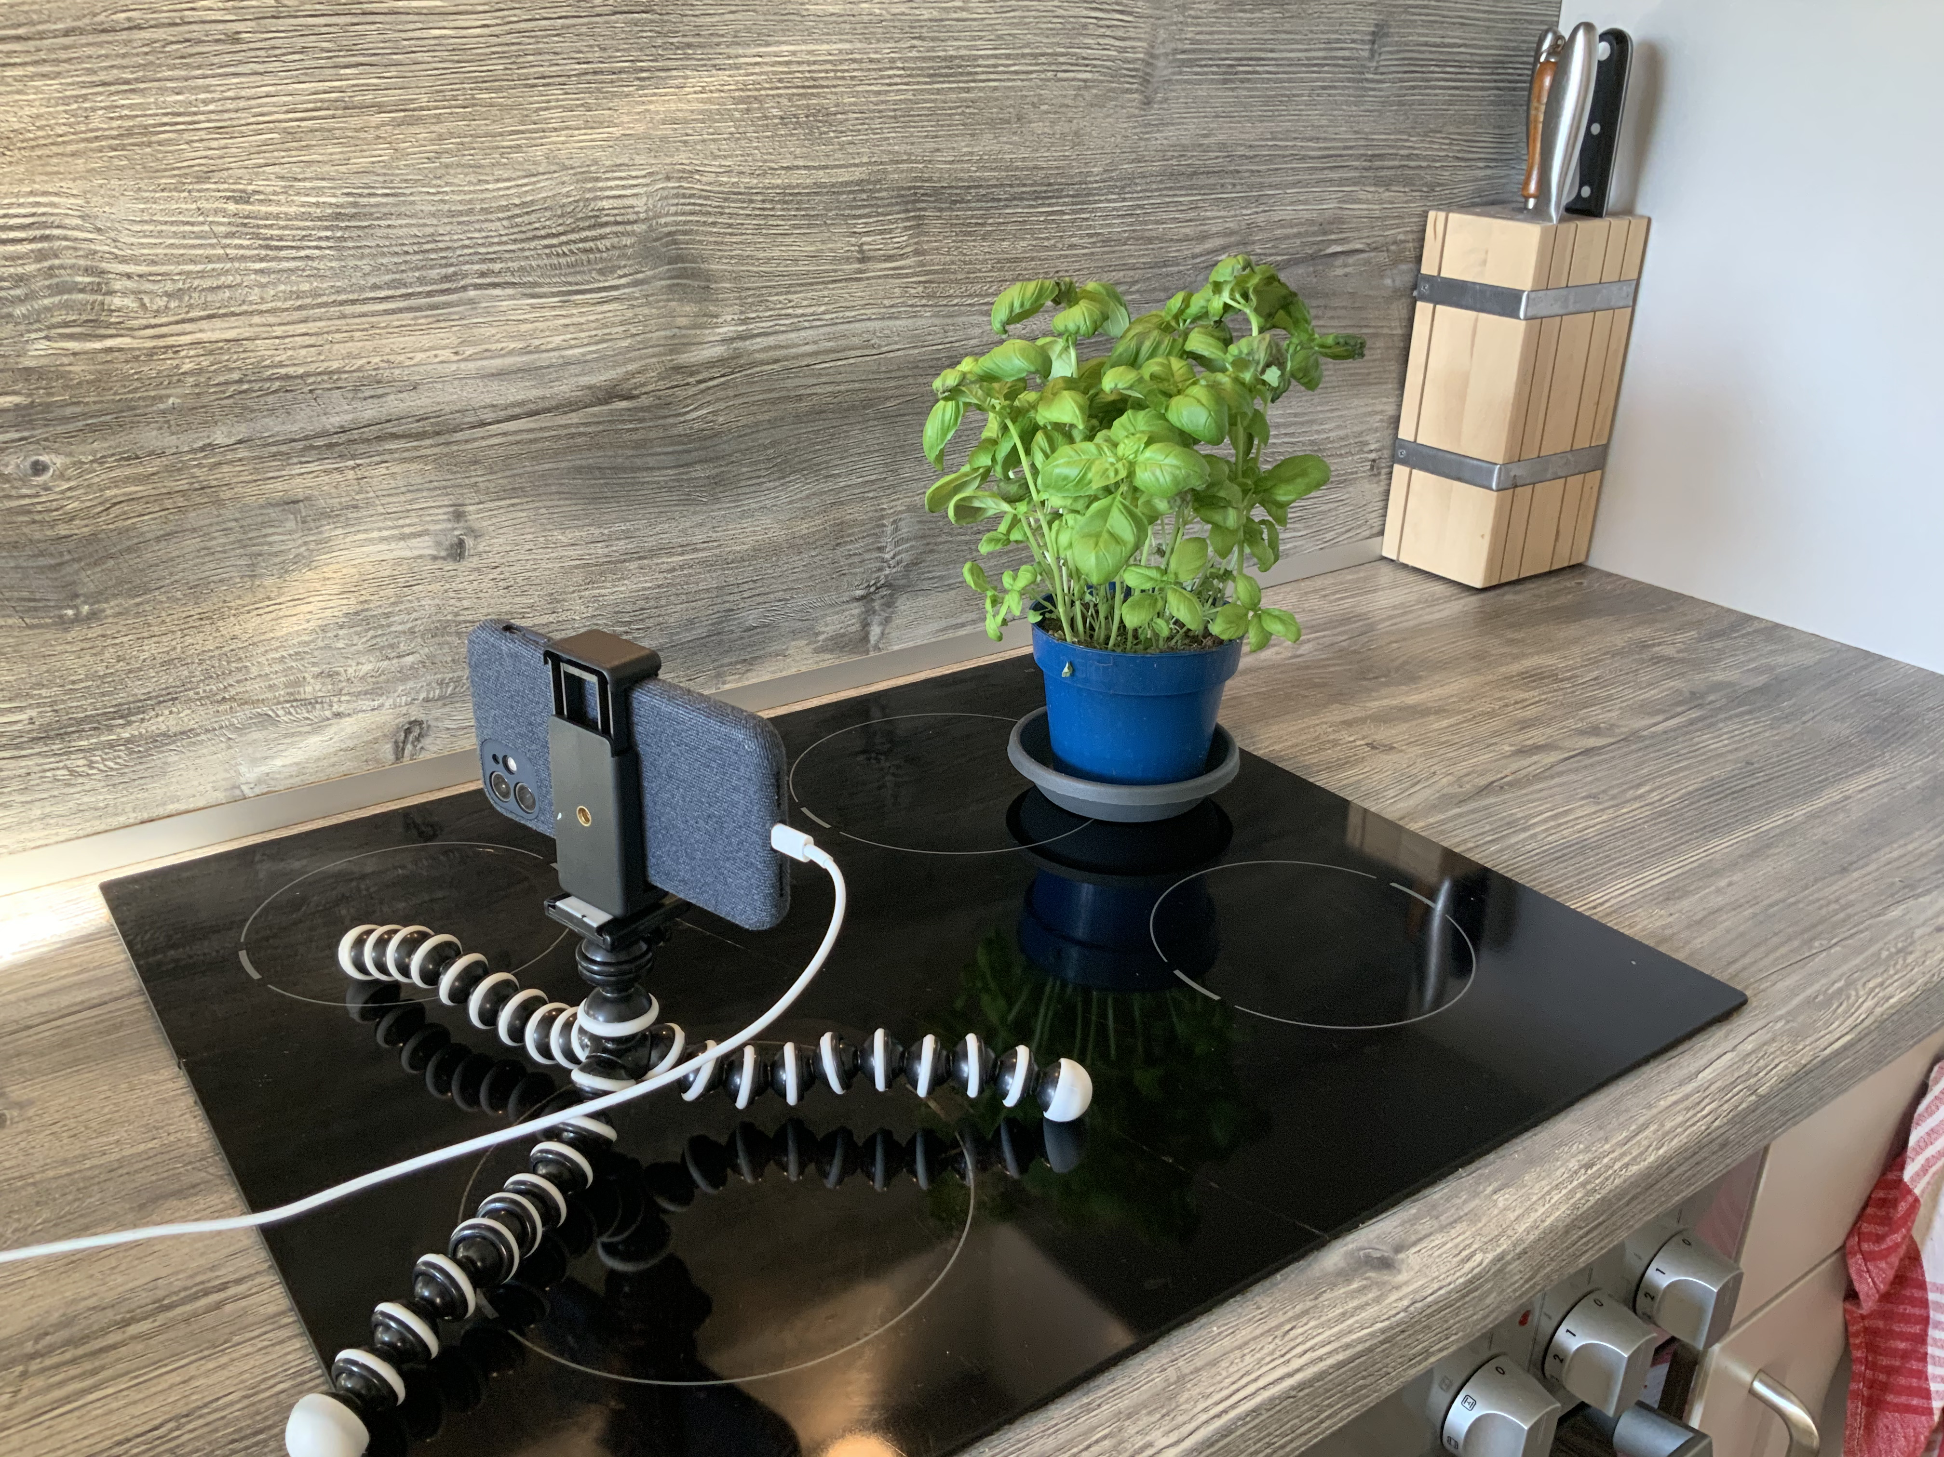
PROBLEMS AND SOLUTIONS
PROBLEM | SOLUTION
Taking images with DLSM took ages | Video processing
Chive did not develop well enough | Replaced by Parsley
Parsley did also not develop well enough | Not resolved
PI Camera Module bad quality | IP Camera
Notes:
BIS HIER KIAN

Slide 8
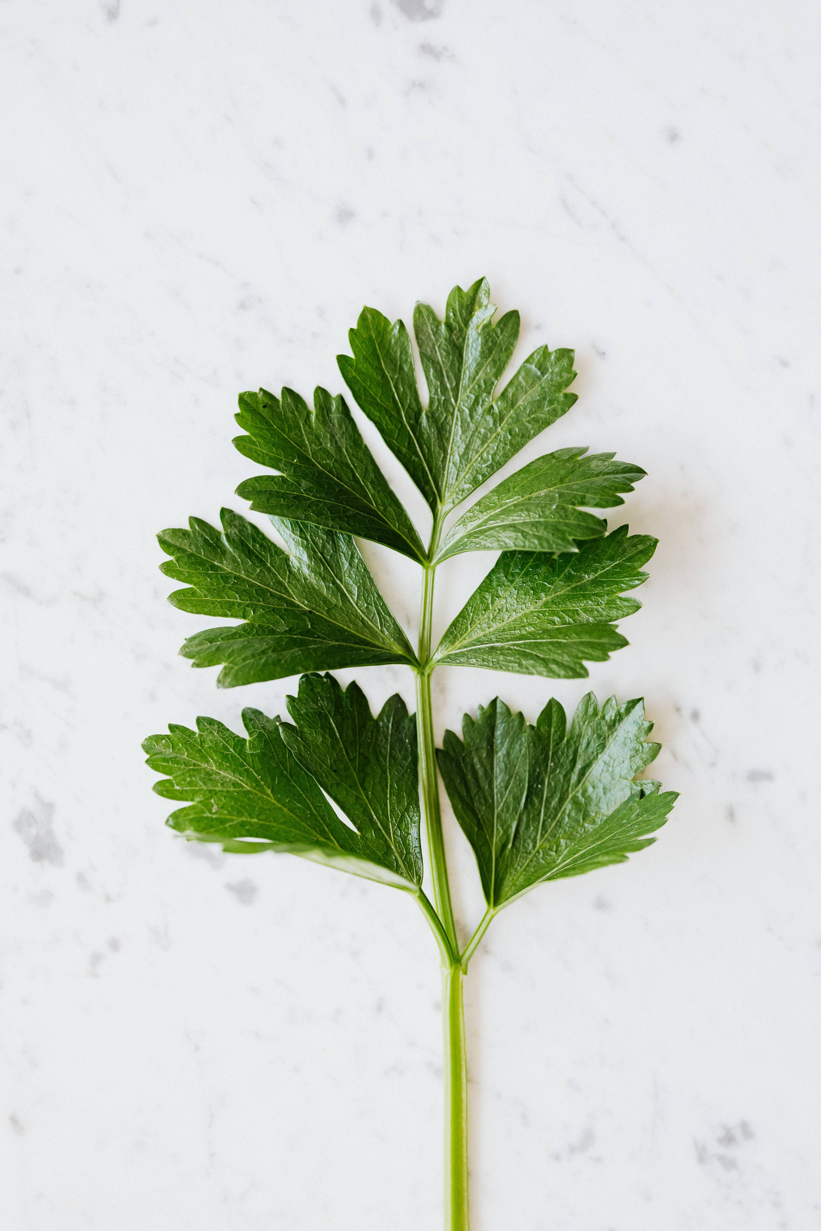
INITIAL IDEAS - MACHINE LEARNING
Custom Convolutional Neural Network
First prototype with a custom model
EfficientNet as backup model
Notes:
CARSTEN

Slide 9
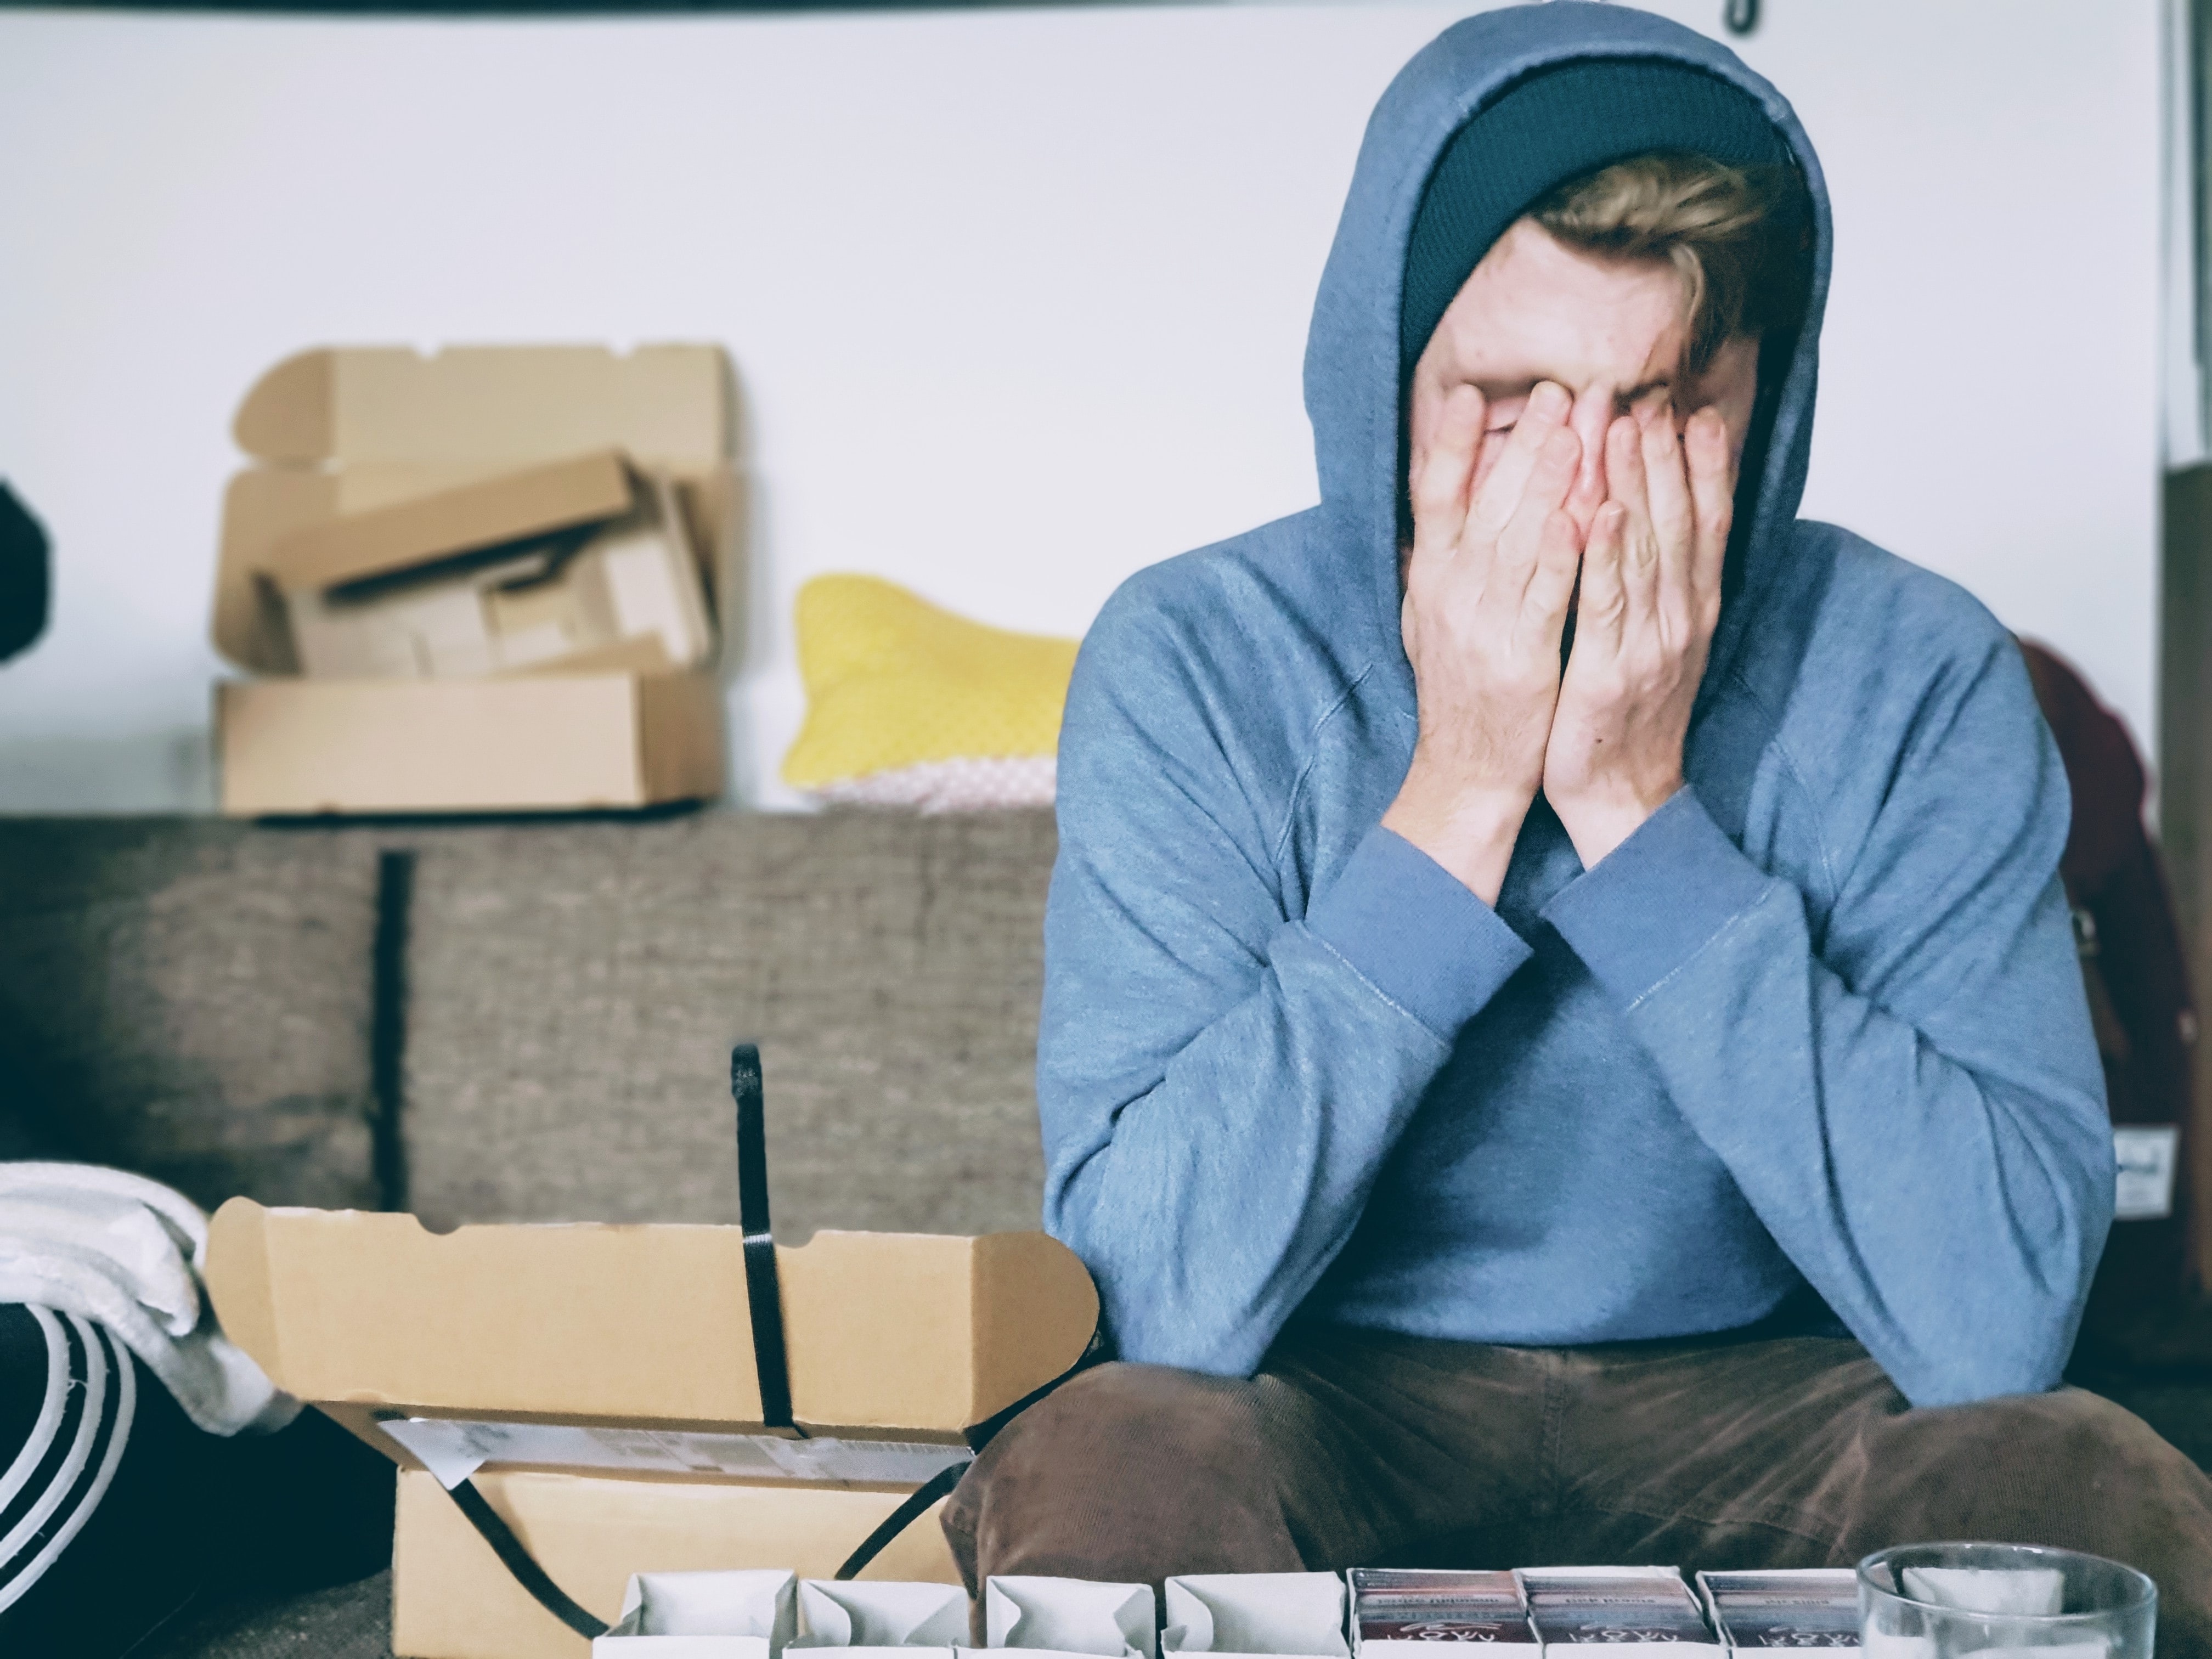
PROBLEMS AND SOLUTIONS
PROBLEM | SOLUTION
Limited resources | Generator
Insufficient validation | K-Fold Validation
Unsatisfying results | EfficientNet
Insufficient generalization | Masking and Cannying

Slide 10






RAM-FRIENDLY DATA GENERATOR

Slide 11
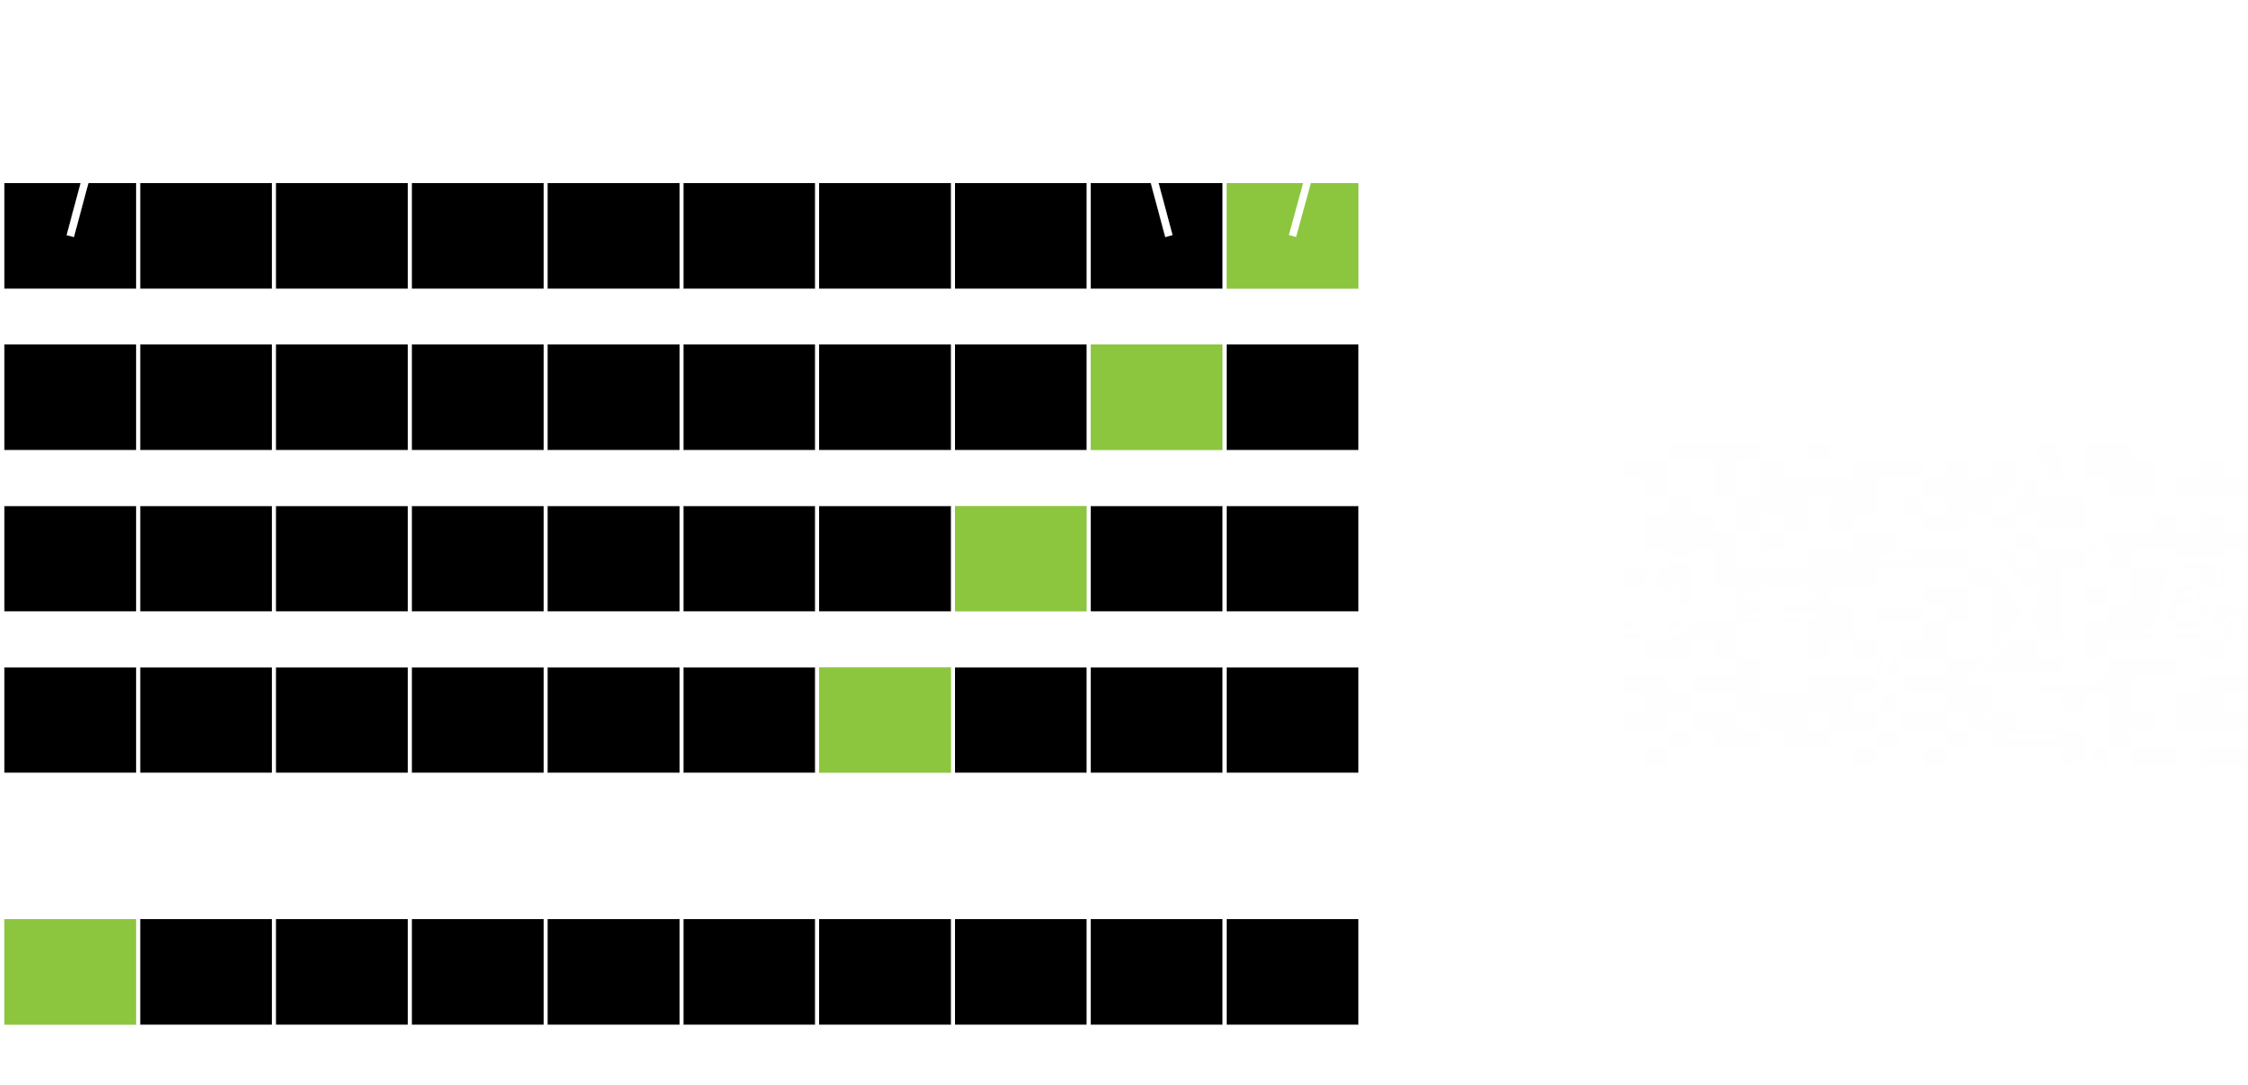
K-FOLD CROSS VALIDATION
Notes:
CARSTEN BIS HIER

Slide 12

THE WHOLE PROCESS
FRAMES
Split video into frames
MANIPULATION
Image-manipulation of frames
K-FOLD
Separate dataset into k-folds
TRAINING
Train different configurations
EVALUATION
Score the best fitting model
MODEL
Use best model for the Raspberry Pi
Notes:
JOHANNES START

Slide 13
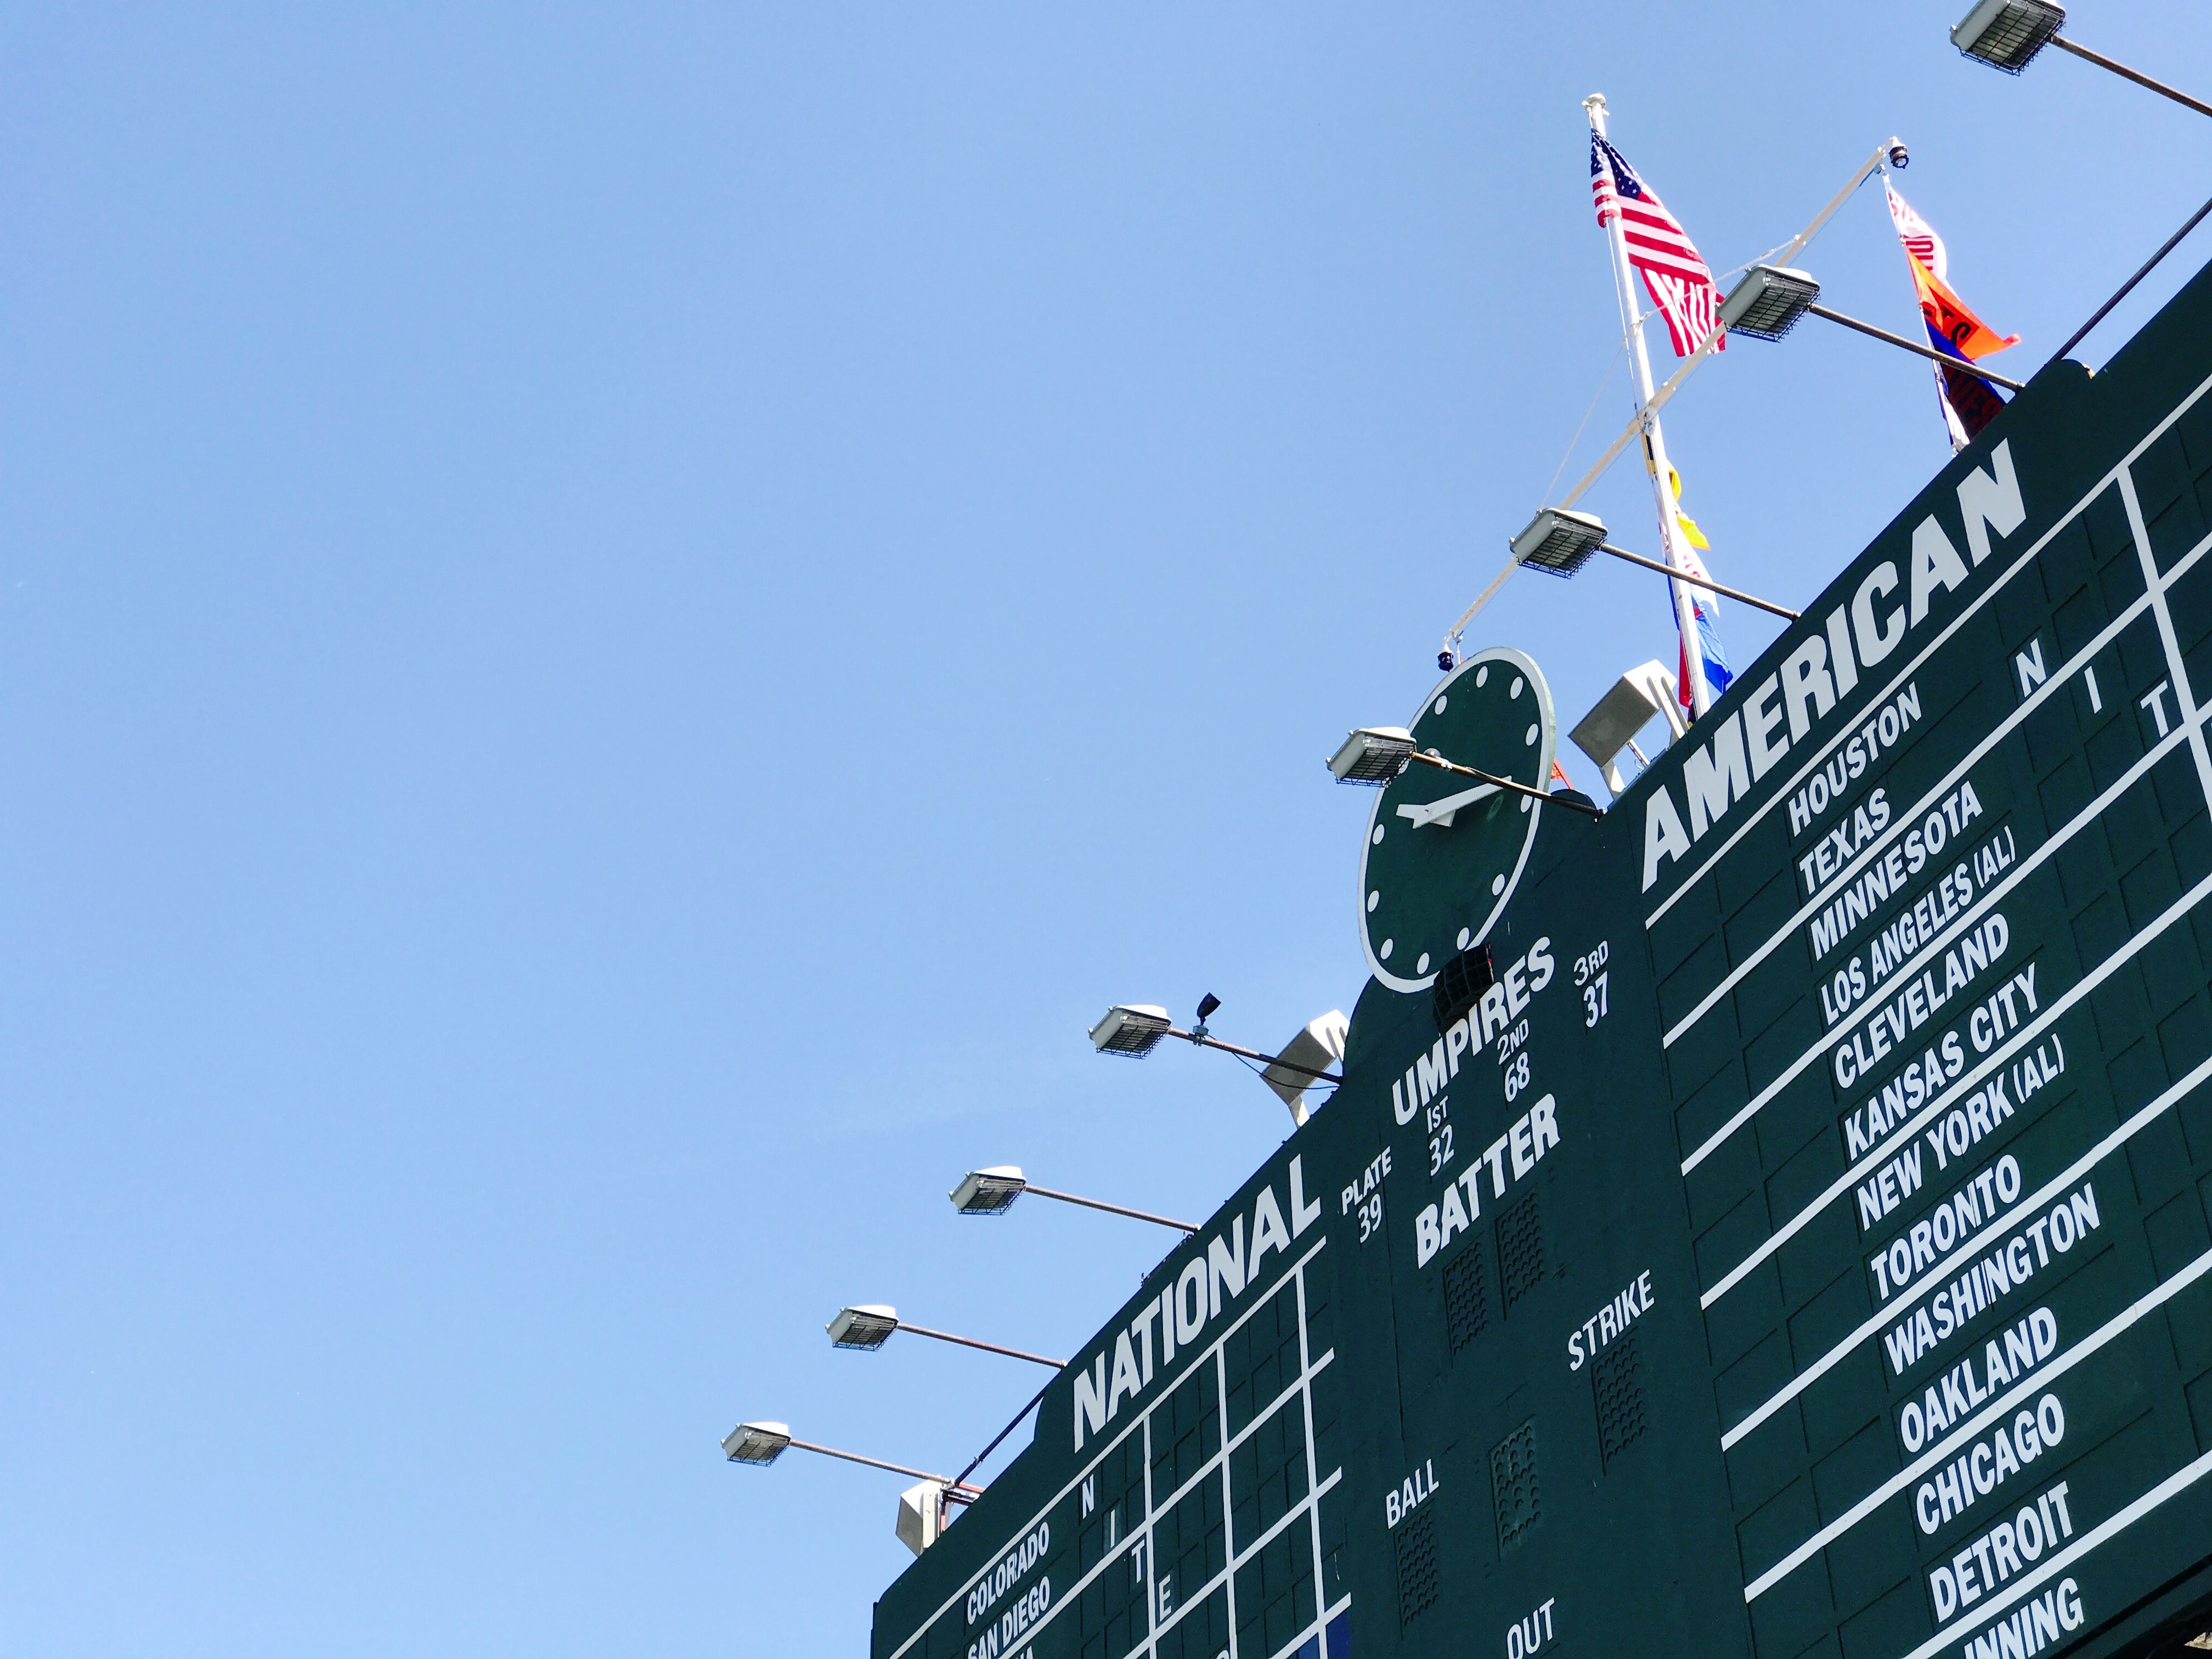
THE SCORING MODEL
01
ALL GENEREATED MODELS
VS NOT KNOWN PLANTS
CUMULATED SUCCESSRATE
03
02
HIT / MISS COUNT = SUCCEESSRATE

Slide 14

MODEL RESULTS
 | B1 | B3 | CUSTOM
RAW | 6.36 | 4.6 | -
MASKED | 9.54 | 7.2 | 4.4
CANNIED | 8.72 | 5.96 | -
MODEL
INPUT
Notes:
JOHANNES ENDE

Slide 15

LIMITATIONS
Machine Learning
RAM issues, Colab crashes are time-consuming. Colab time limit.
Camera
Bad quality of Pi camera configuration time-consuming. (No perfect setup)
Plants
Varying quality of bought plants. Behaved very different while drying.
RECOMMENDATIONS
Machine Learning
No usage of colab. Use local ressources or from university.
Performance issues might be resolved together with the following issues.
Camera
Usage of high-quality Pi or IP camera from the beginning. Also the video approach is very time-saving.
Plants
Grow your own plants. From seed to soil. Might be intresting to observe the growing process.

Slide 16
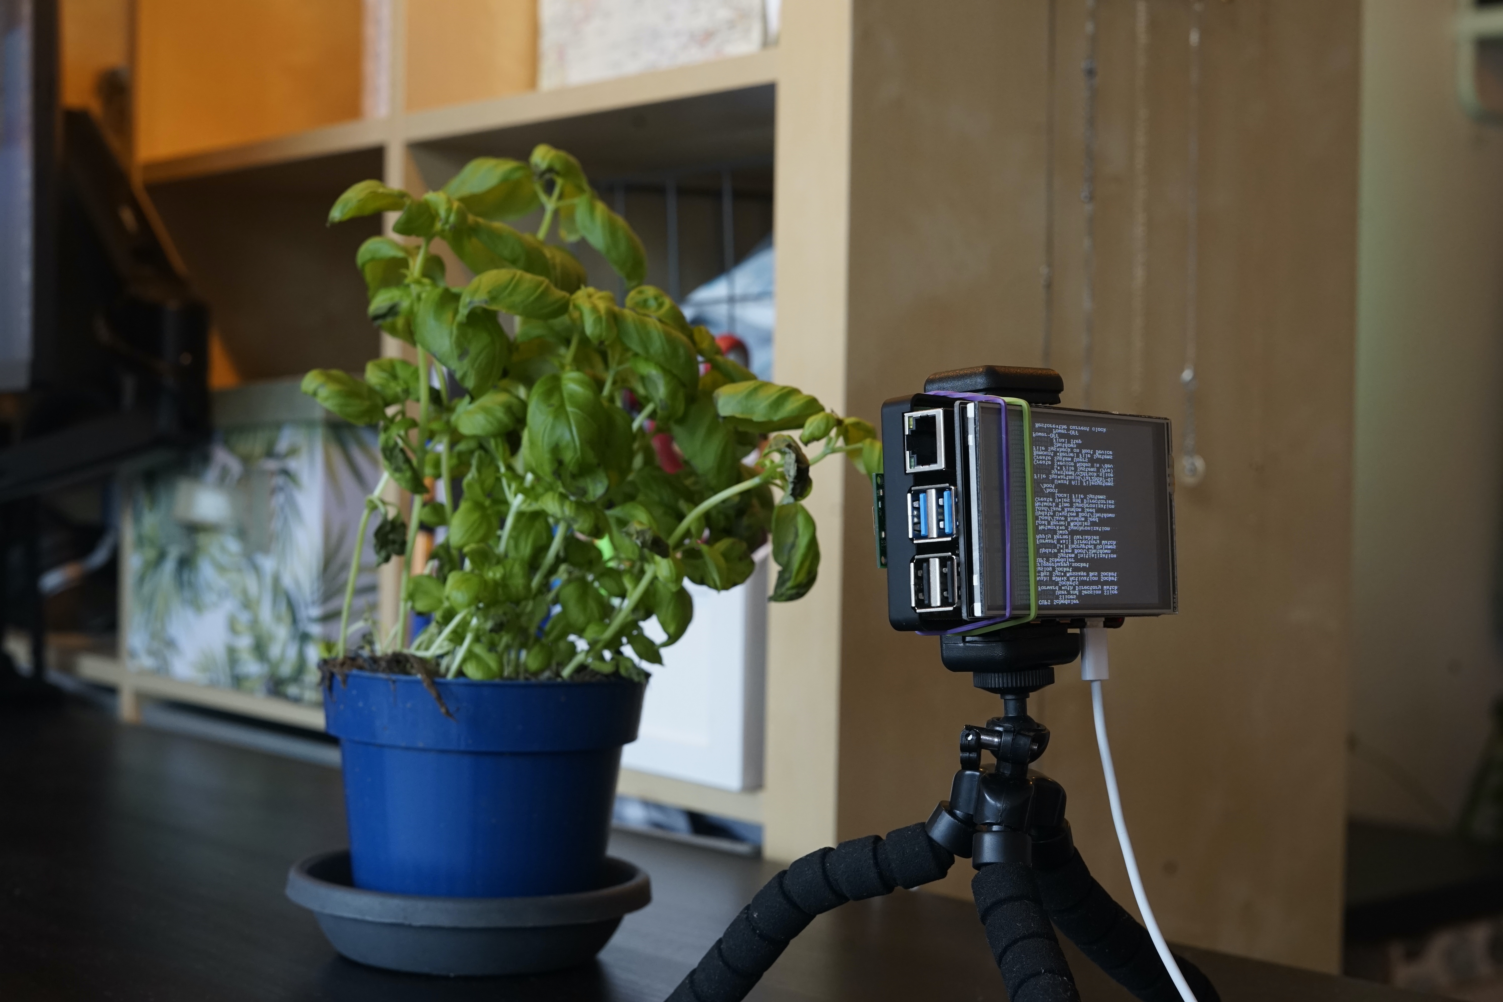
THE DEMO

Slide 17
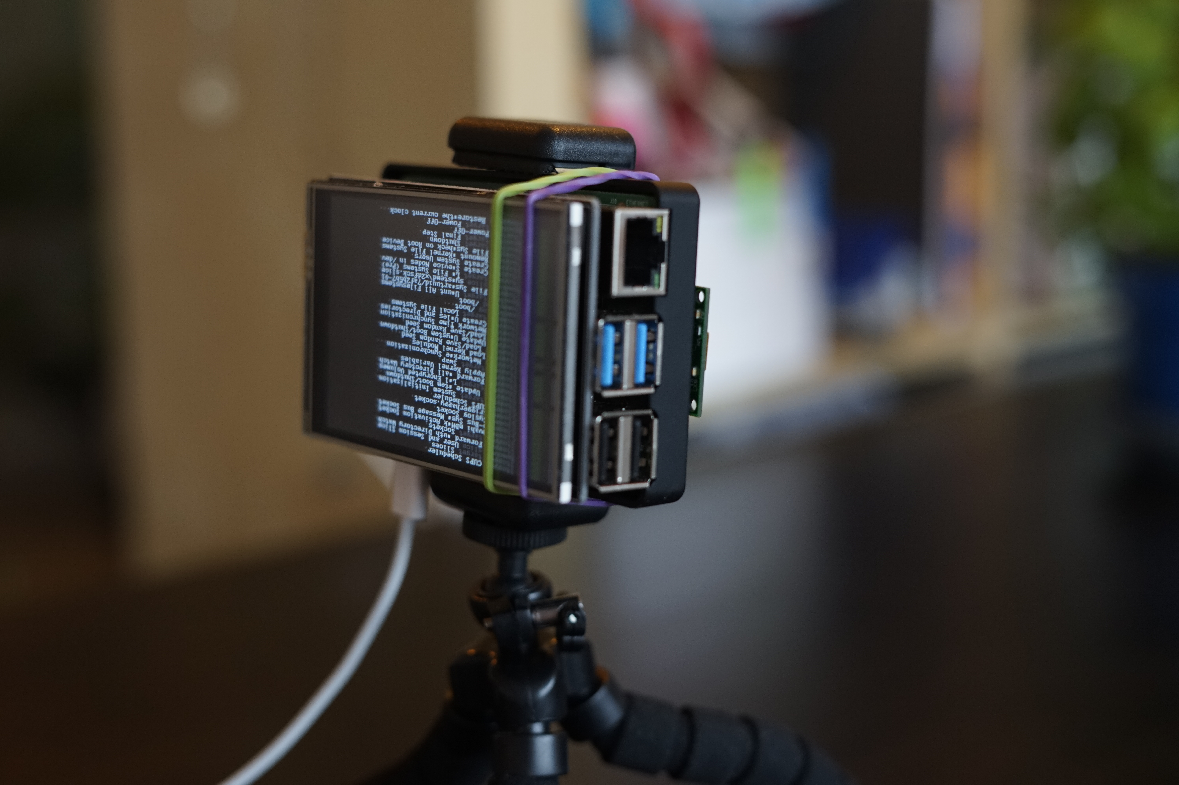
OPEN DISCUSSION

Slide 18
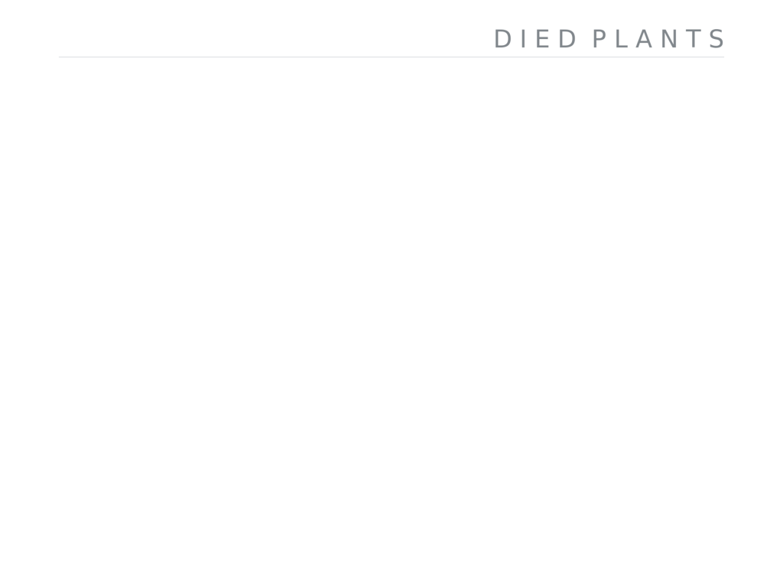
Stock-Images: pexels.com
Vector-Icons: flaticons.com
SOURCES AND DIED PLANTS

Slide 19
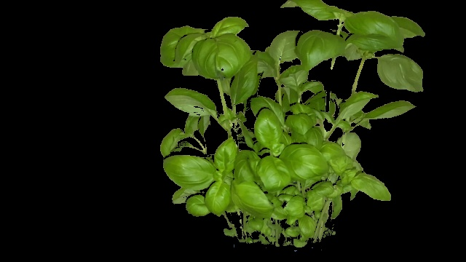


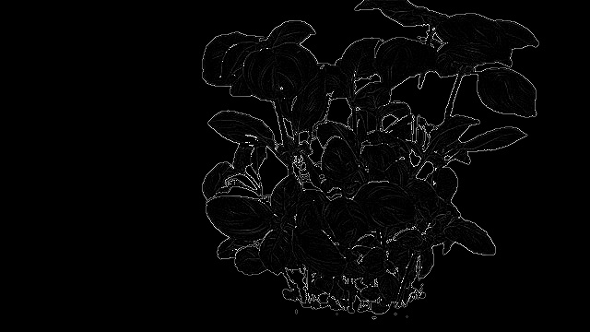
ORIGINAL
GREEN MASK
MASK + CANNY
GRAYSCALE + LAPLACE
MASK + GRAY + LAPLACE
INTERESTING FILTER RESULTS

